Slide 1
Modeling the Size-of-Source Effect in Thermography
Using a Measured MTF Extended by a Parametric Scattering Model
Jannik Ebert, Miguel-David Mendez-Bohorquez, Robert Schmoll, Andreas Kroll
QIRT 2026
Naples, Italy, July 1st 2026

Slide 2

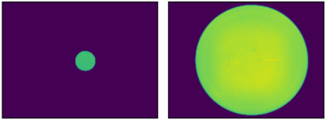



Motivation
Input Signals
System
Output Signals
$$T_{max}=320 °C$$
$$T_{max}=312 °C$$
$$T_{max}=316 °C$$
Modulation Transfer Function
Size-of-Source Effect
Measured temperature
depends on object size
Aim: Measure the MTF and predict the SSE
SSE
Problem: MTF is based on diffraction in the optics and affects only small objects
Solution: Extend the MTF with a Parametric Model to include additional effects
Modeled SSE
Temperature in °C
(calculated from MTF)
Diameter in px
Notes:
Emissivity
Diffraction based MTF → Deshalb unvollständige Beschreibung SSE

Slide 3
Outline
MTF fundamentals
Influence of scattering on the MTF
Modeling approach
Experimental setup
Comparison between measured and modeled SSE

Slide 4
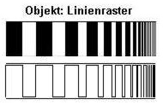
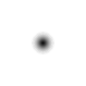
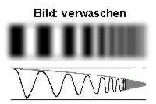


Modulation Transfer Function (MTF)
MTF = $ℱ$ourier transform of the spatial impulse response (PSF)
→ High spatial frequency components are suppressed
large measurement deviations
INPUT
PSF
OUTPUT
*
=
relevant for large
objects in the image
Modulation
100%
MTF
diffraction limit
high frequency signals (small objects, fine details)
can‘t be resolved
Spatial frequency $f_{x}$
Notes:
MTF linear 1D!

Slide 5
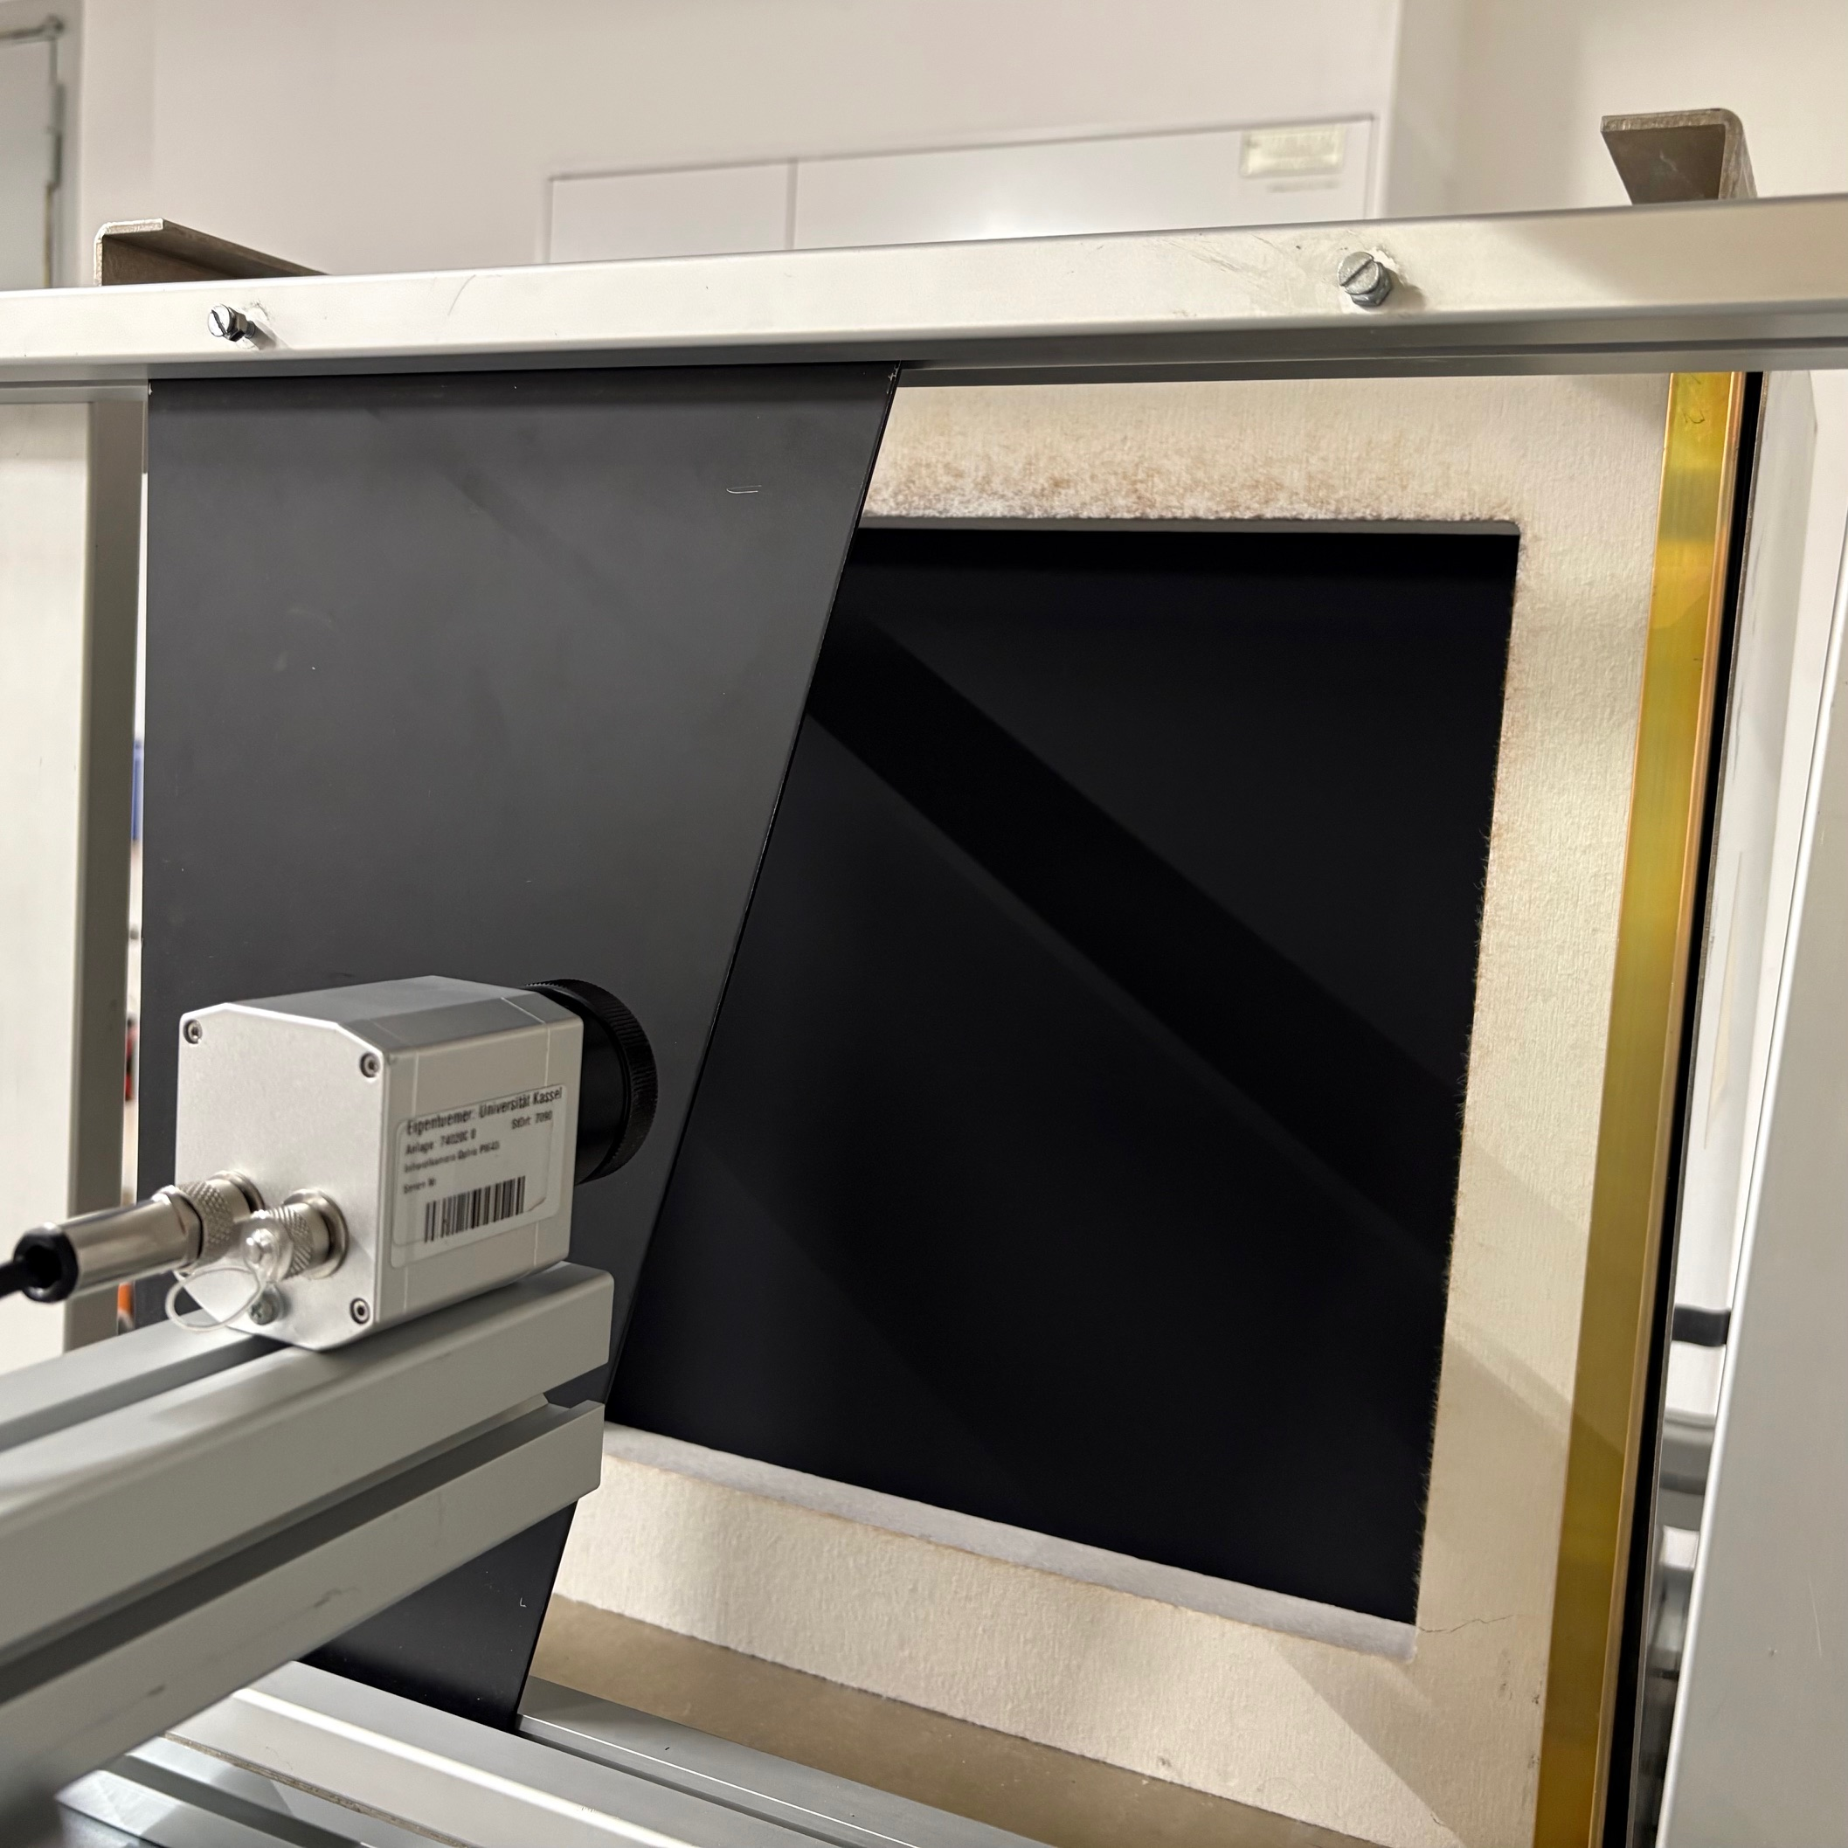
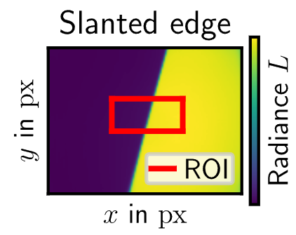
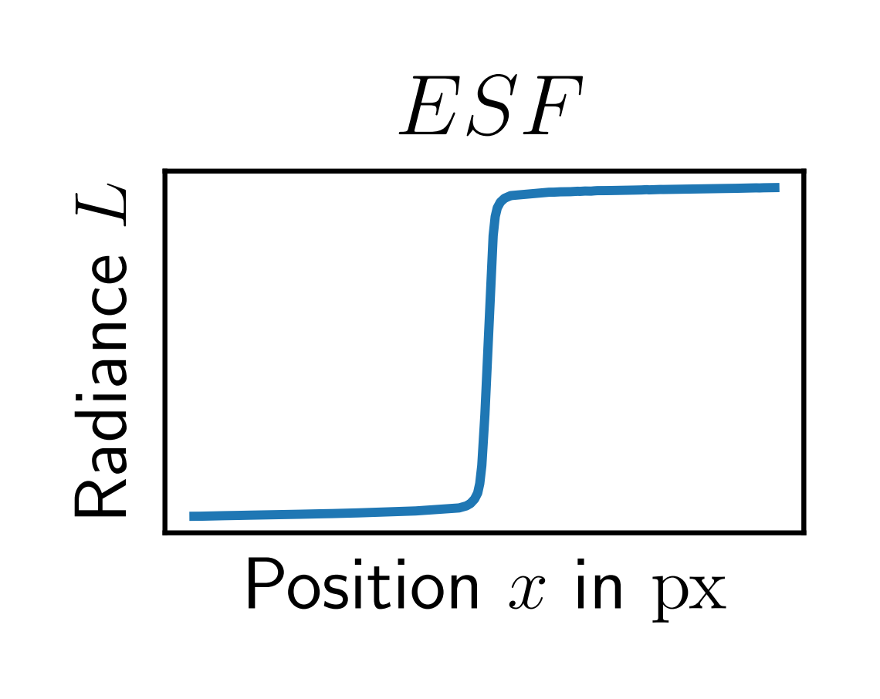
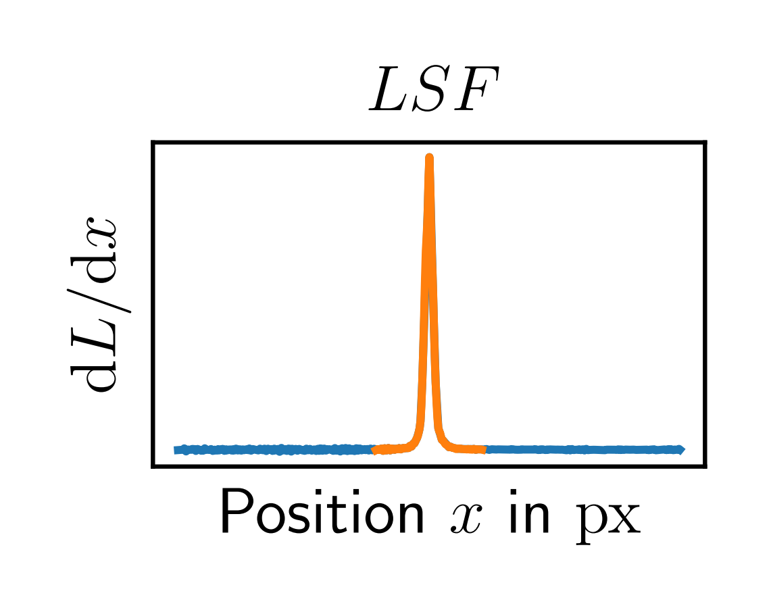
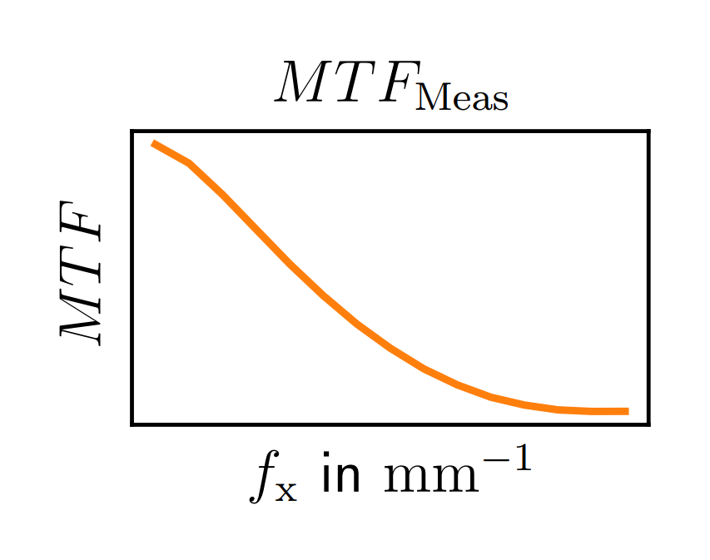
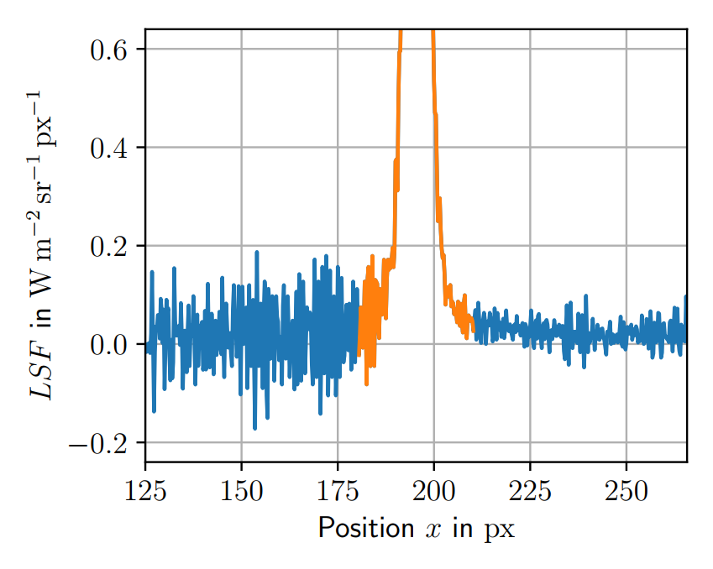

MTF Measurement and Extension
Evaluation of the MTF with the edge response (BS ISO 12233:2017)
edge spread function
line spread function
$$𝓕$$
diffraction based
Slanted edge
sharp peak:
high spatial frequency contributions
wings:
low spatial frequency contributions
(impractical to measure)
model the wings in the spatial frequency domain
(inspired by the Harvey-Shack theory)
$STF=A+B∙\exp\left(−π{\left(C∙f_{x}\right)}^{2}\right) →$ ${MTF}_{Model}=MTF∙STF$
fraction of radiation
contained in the wings
~ width of the wings
measured
parametric

Slide 6





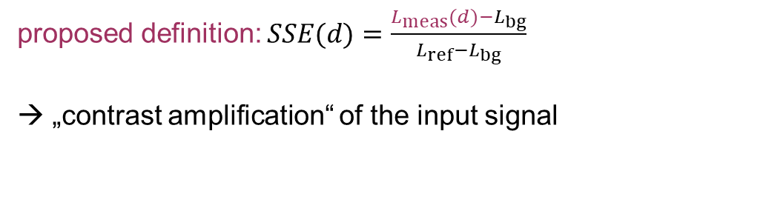


Modeling Approach
Calculating the SSE with the measured MTF and the parametric STF
measured value: $L_{meas}(d)$
$$L_{ref}$$
$$ℱ$$
multiplication
with MTF and STF
$$ℱ^{−1}$$
$L_{bg}$
$d$
SSE
proposed definition: $SSE(d)=\frac{L_{meas}(d)−L_{bg}}{L_{ref}−L_{bg}}$
„contrast amplification“ of the input signal
1
0
Diameter $d$

Slide 7
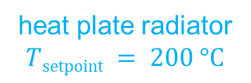
Experimental Setup (MTF Measurement)
coated metal
sheet
collect one thermogram of the slanted edge
(contains 50 frames to account for noise)
Optris PI450
(LWIR)
heat plate radiator $Tsetpoint = 200 °C$
Notes:
SSE: time sequence

Slide 8
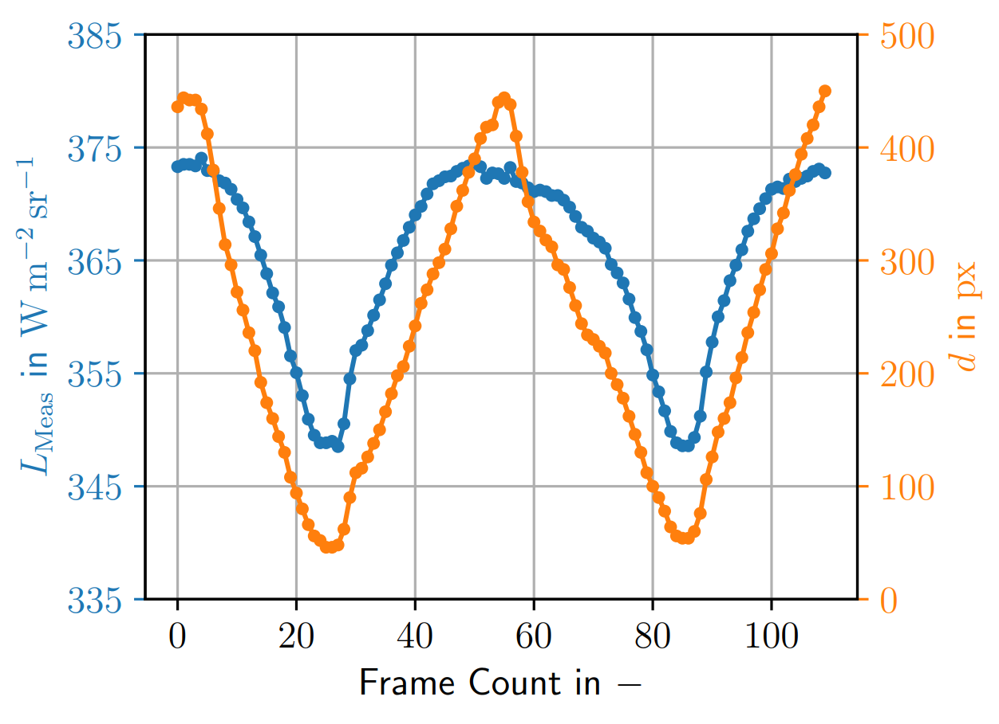
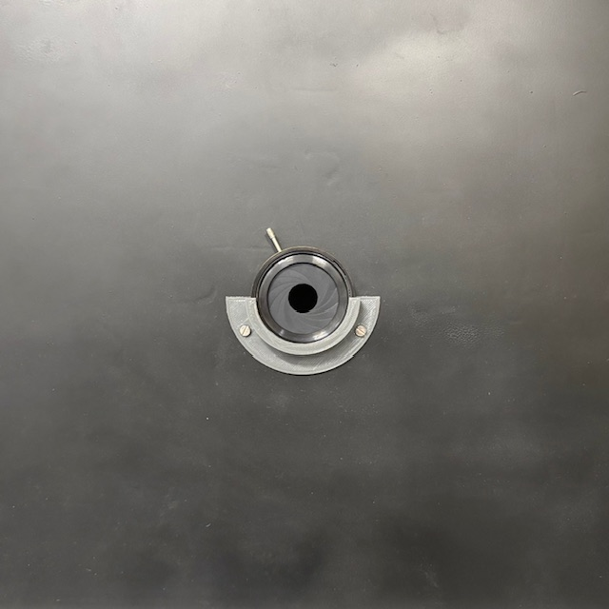
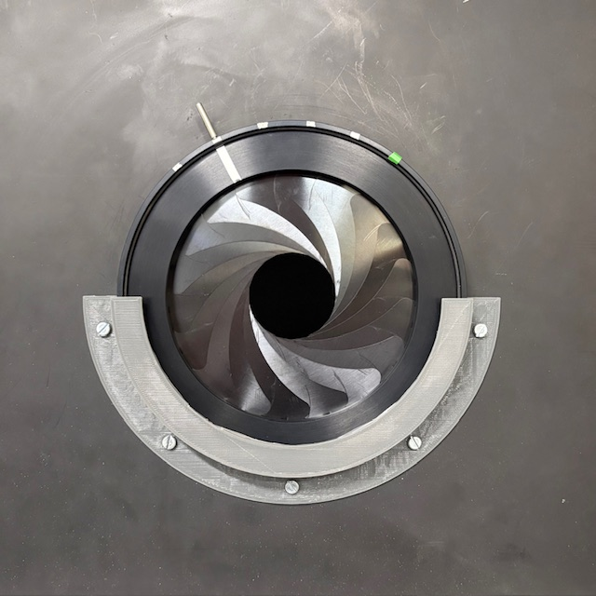



Experimental Setup (SSE Measurement)
Identical setup to MTF measurement
→ replace slanted edge with iris diaphragms
Open and close the iris diaphragms for 2 cycles
→ times series
circle detection
(position and diameter)
open
open
FOV
FOV
close
close
$$L_{Meas}$$
(average radiance)
$$T_{radiator}=200 °C$$

Slide 9
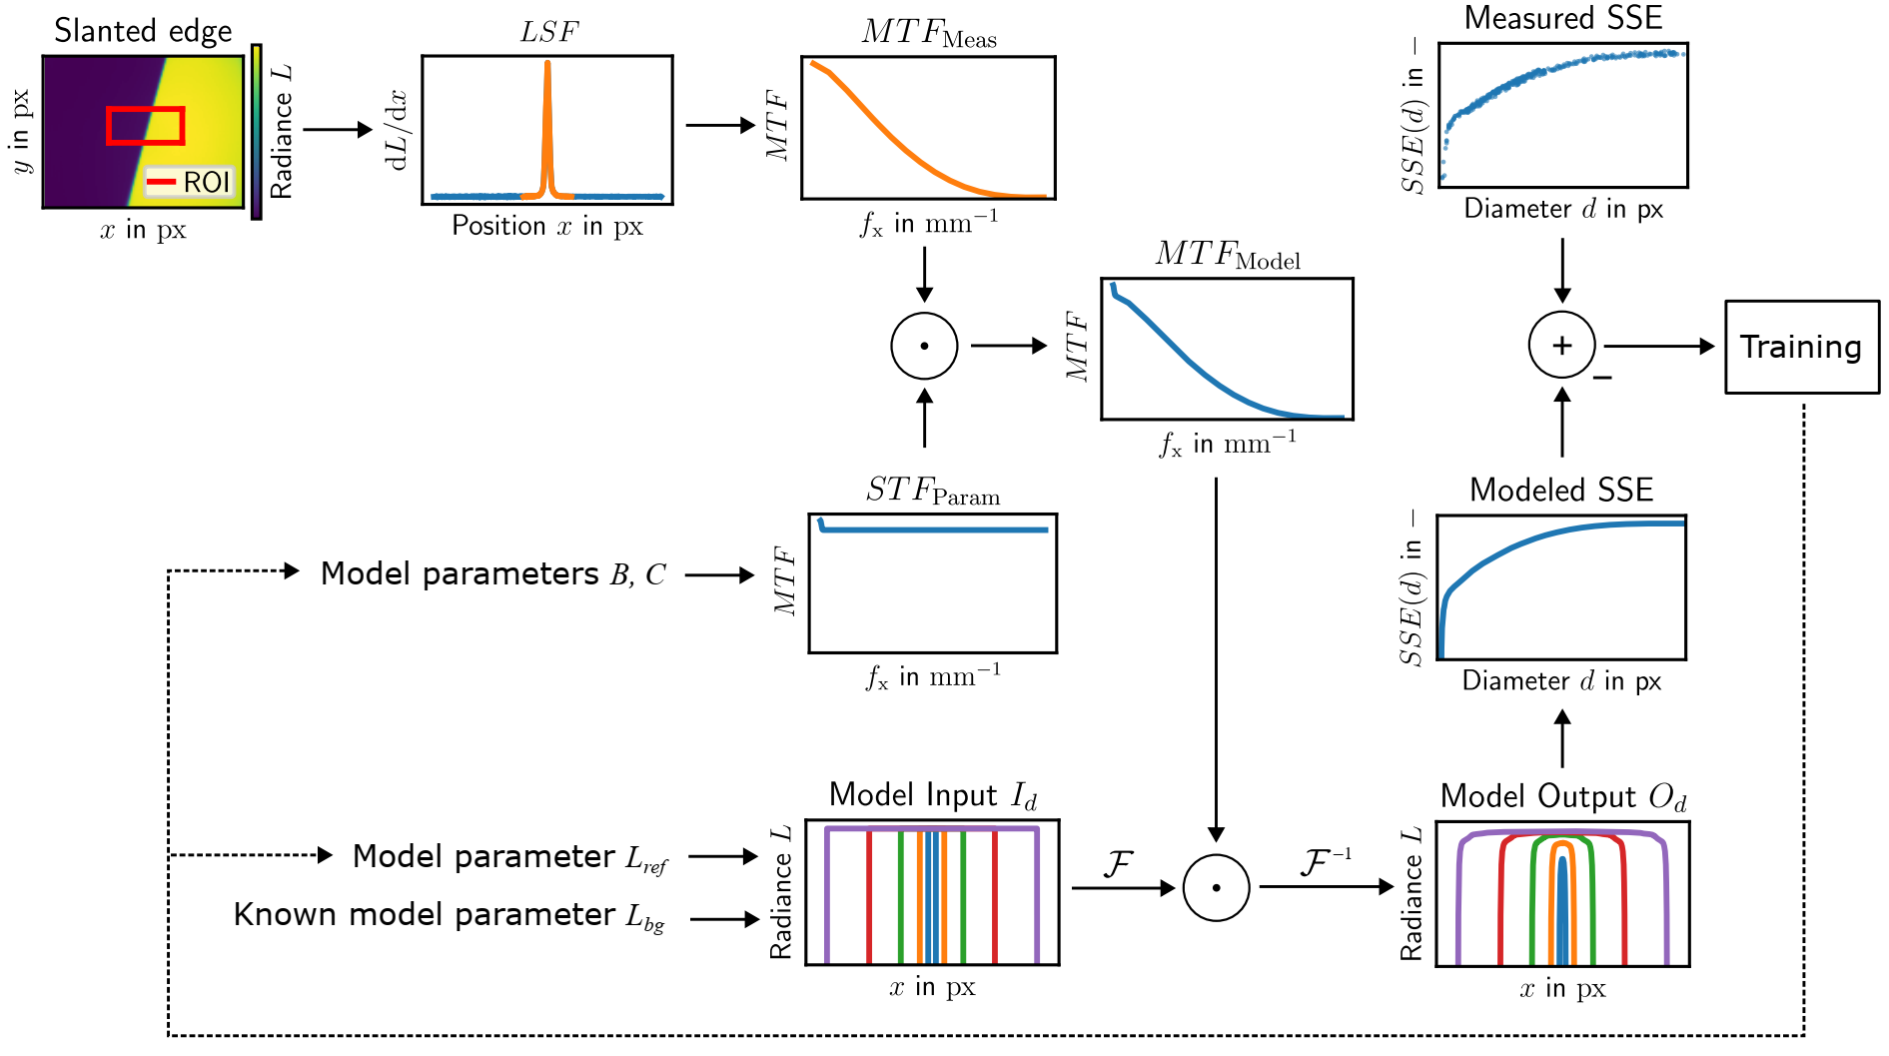
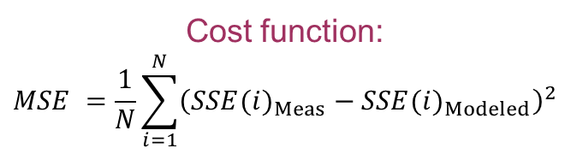
Parameter optimization
Cost function:
$$MSE =\frac{1}{N}\sum_{i=1}^{N}{{\left({SSE(i)}_{Meas}−{SSE(i)}_{Modeled}\right)}^{2}}$$
Optimization strategy:
Differential evolution
initial estimate
Nelder-Mead algorithm
→ refinement

Slide 10
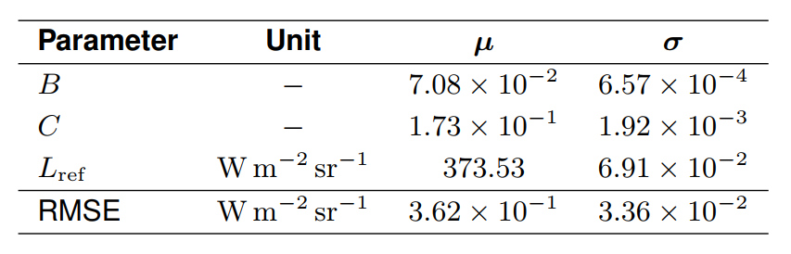
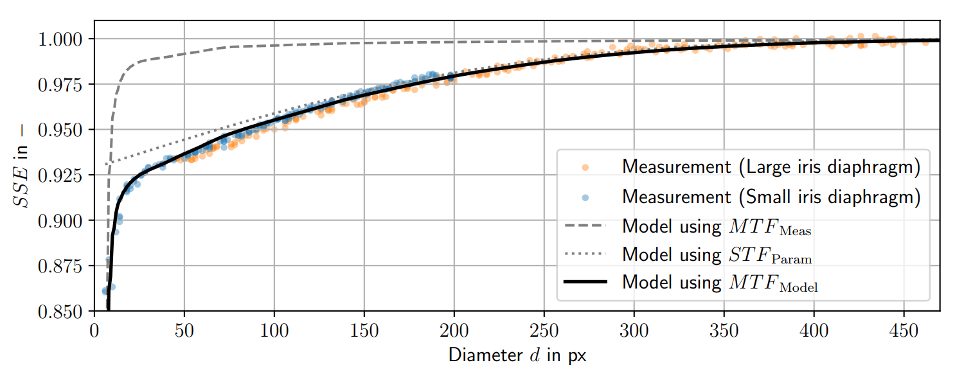

Results (Modeled and Measured SSE)
Parameters found
using a bootstrap analysis
with 20 realizations
$L_{Meas}, L_{Modeled}$ (radiance values)
detector width (382 px)
Notes:
Text hinzufügen (Stichpunkte, wichtigste)
Ergebnisse Tabelle

Slide 11
Conclusion & Outlook
The proposed model
  Enables a descripton of the SSE within a linear systems framework
  Significantly improves the characterization of the SSE
  by incorporating additional effects
  Enables modeling of individual camera components (lenses, optical filters, …)
In future work
  Extend the model to 2D
  Derive a convolutional filter to compensate the SSE
  → reduce measurement uncertainty
  Inform the model with physical kowledge

Slide 12
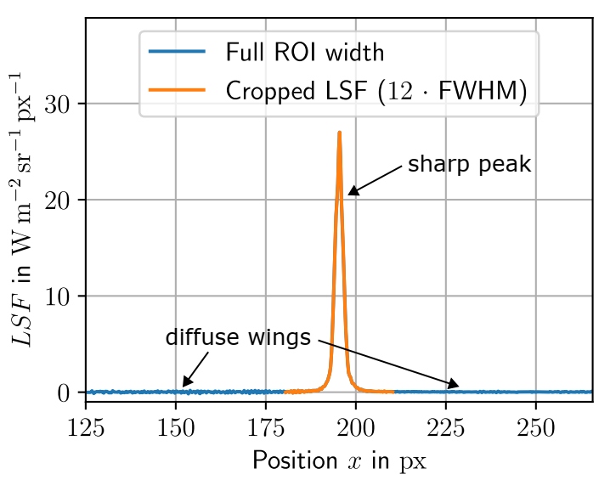
End of the Presentation
Thank you for your attention!
Contact details:
Jannik Ebert (B. Sc.)
Measurement and Control Research Group
University of Kassel, Kassel, Germany
mail: jannik.ebert@mrt.uni-kassel.de
visit us: www.uni-kassel.de/fb15/mrt

Slide 13
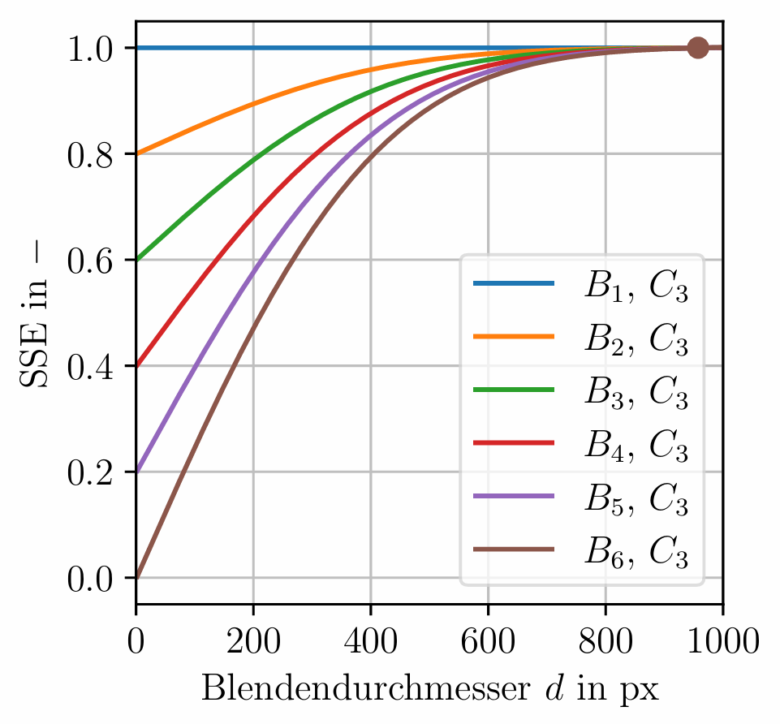
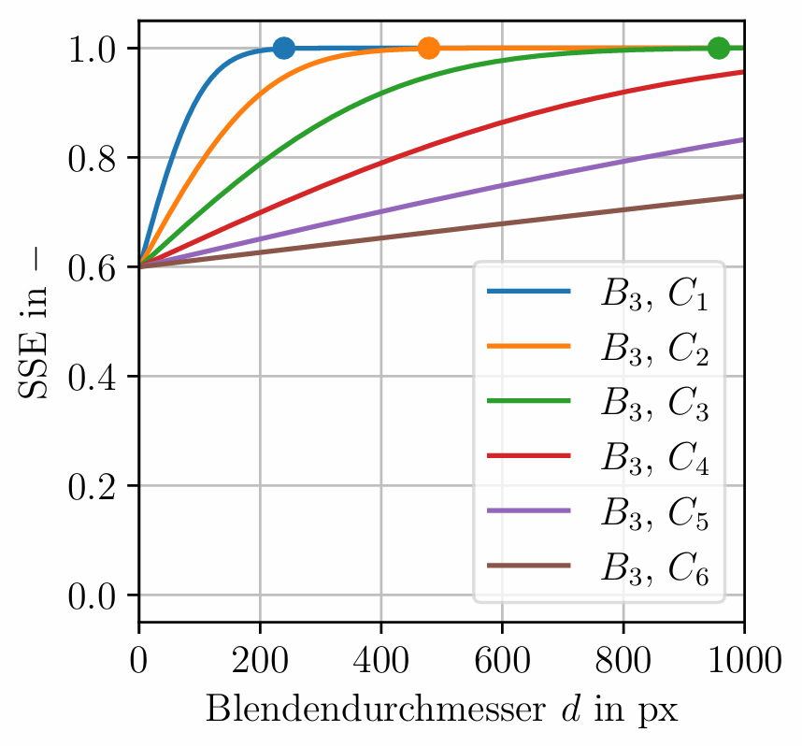


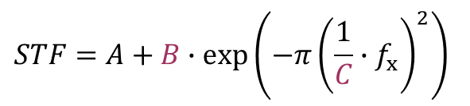
Influence of the parameters on the modeled SSE
$$STF=A+B∙exp⁡\left(−π{\left(\frac{1}{C}∙f_{x}\right)}^{2}\right)$$
$B$ increases:
$C$ increases:
SSE becomes more profound
SSE converges more slowly

Slide 14
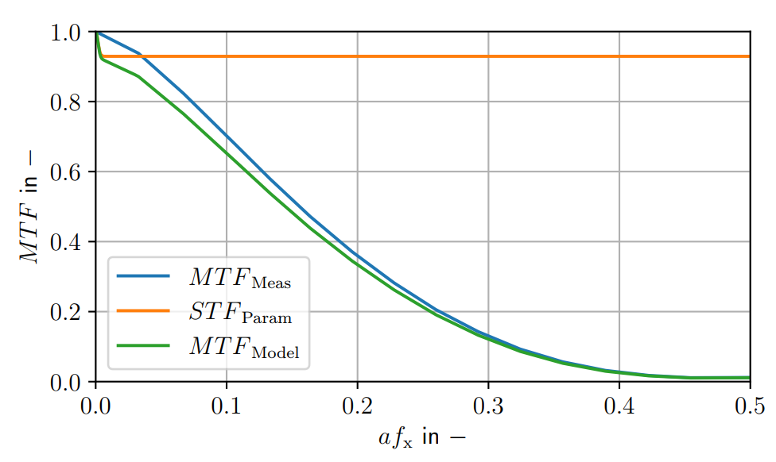
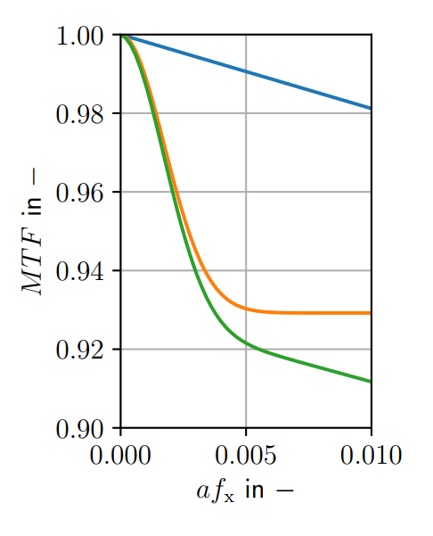
Results (Modeled and Measured MTF)
Notes:
Text hinzufügen

Slide 15
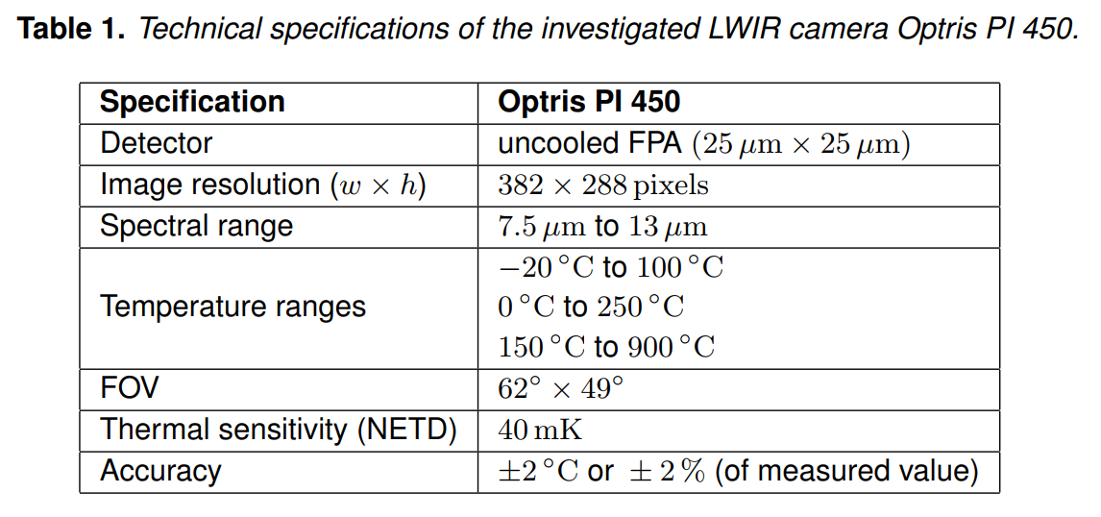
Camera Specifications

Slide 16
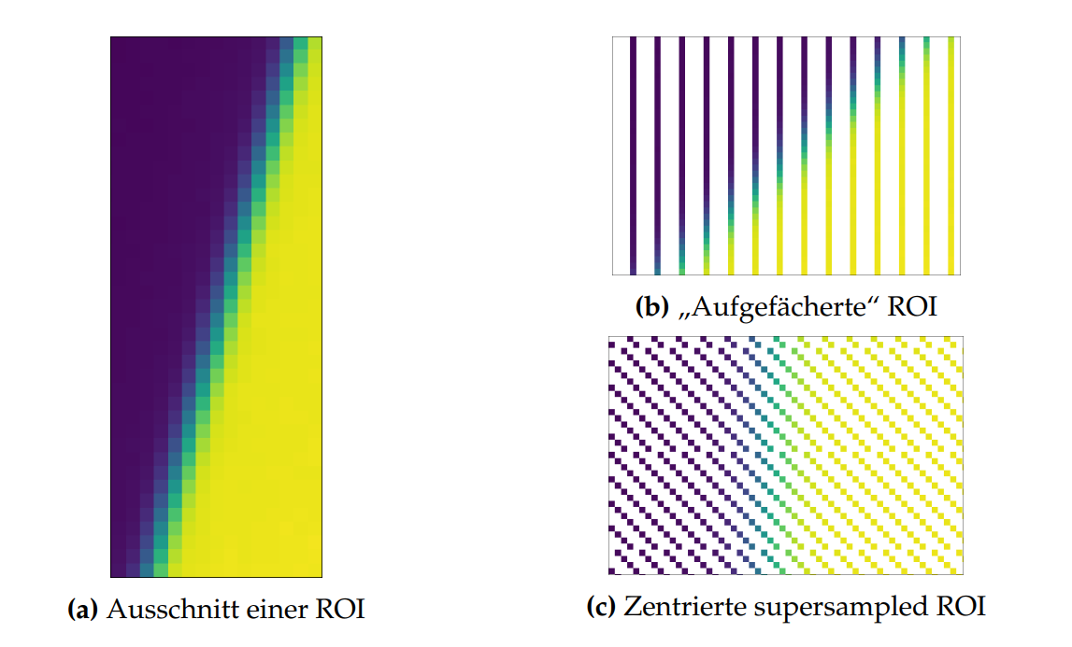
Edge-Spread-Function Algorithm

