Slide 1

Improving Meltpool Monitoring Realibility with deep segmentation of infared thermographic data
by Iago Gil-Cortés¹, Paul D. Rosero-Montalvo¹, Martin Martinez-Baltar¹
¹Smart Systems and Smart Manufacturing Group, AIMEN Technology Centre,
Porriño, 36400,Spain
Thrusday, 2 July 2026

Slide 2
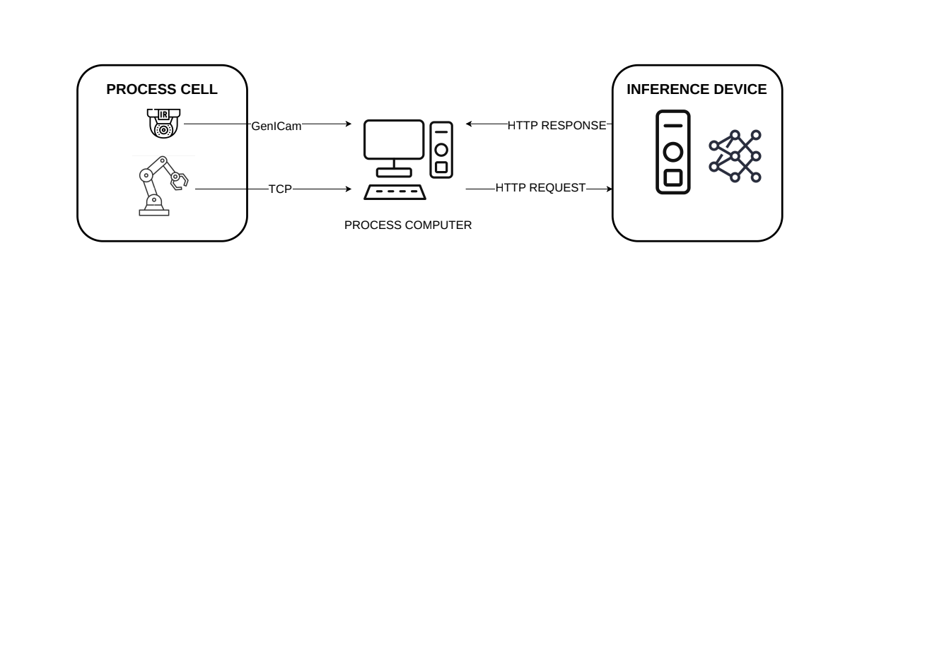
Monitoring architecture
The same model can run as an edge device or as small inference server
Notes:
First, I would like to introduce the monitoring architecture considered in this work.
The infrared camera sends thermal frames to the industrial PC, while process-related information can be exchanged with the robot or control system.
In this configuration, the segmentation model can be executed on an external inference device.
The industrial PC sends the frame, and the inference device returns the predicted meltpool mask and the corresponding descriptors.
So, the model is not considered as an isolated neural network.
It is part of a monitoring pipeline intended to transform thermographic data into useful process information.

Slide 3
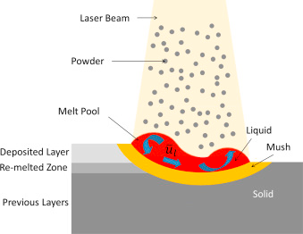
Why monitoring the meltpool?
Laser-based additive manufacturing
Meltpool geometry is linked to process stability
Variations may indicate overheating, lack of fusion or abnormal interaction
Infrared thermography provides non-contact thermal monitoring
Reliable feature extraction is needed for supervision and future control
Notes:
Inside this monitoring architecture, the meltpool is one of the most informative regions of the process.
Its geometry and thermal behaviour are closely related to process stability and final part quality.
Variations in meltpool width, area, shape, or thermal distribution may indicate process instabilities such as overheating, lack of fusion, or abnormal laser-material interaction.
Infrared thermography is useful because it provides non-contact thermal monitoring at high acquisition rates.
However, to use this information for supervision or future control, we first need reliable feature extraction from the meltpool region.

Slide 4
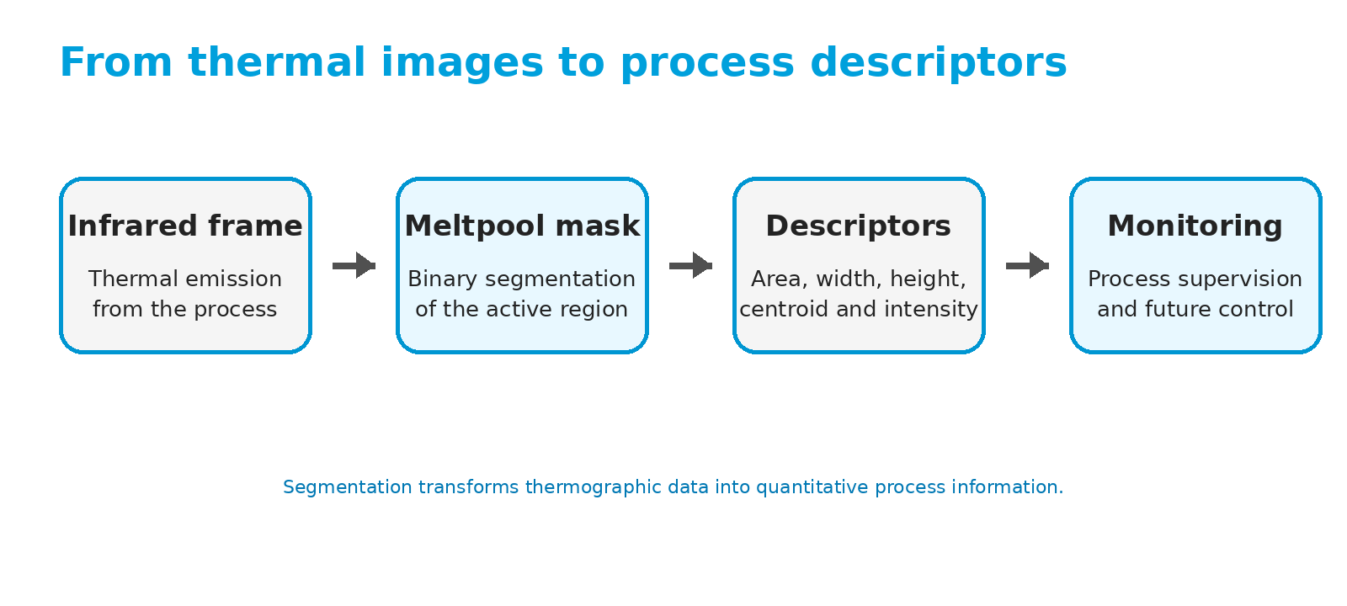
From thermal images to process descriptors
Notes:
The segmentation mask is not the final objective by itself.
It is an intermediate step.
Starting from the infrared frame, the objective is to obtain a meltpool mask.
From this mask, we can extract compact numerical descriptors, such as area, width, height, centroid position, and intensity-based indicators.
These descriptors are easier to use for process supervision, trend analysis, and future closed-loop control than the raw thermographic image.
So, in this work, segmentation is understood as the step that converts thermographic data into quantitative process information.

Slide 5
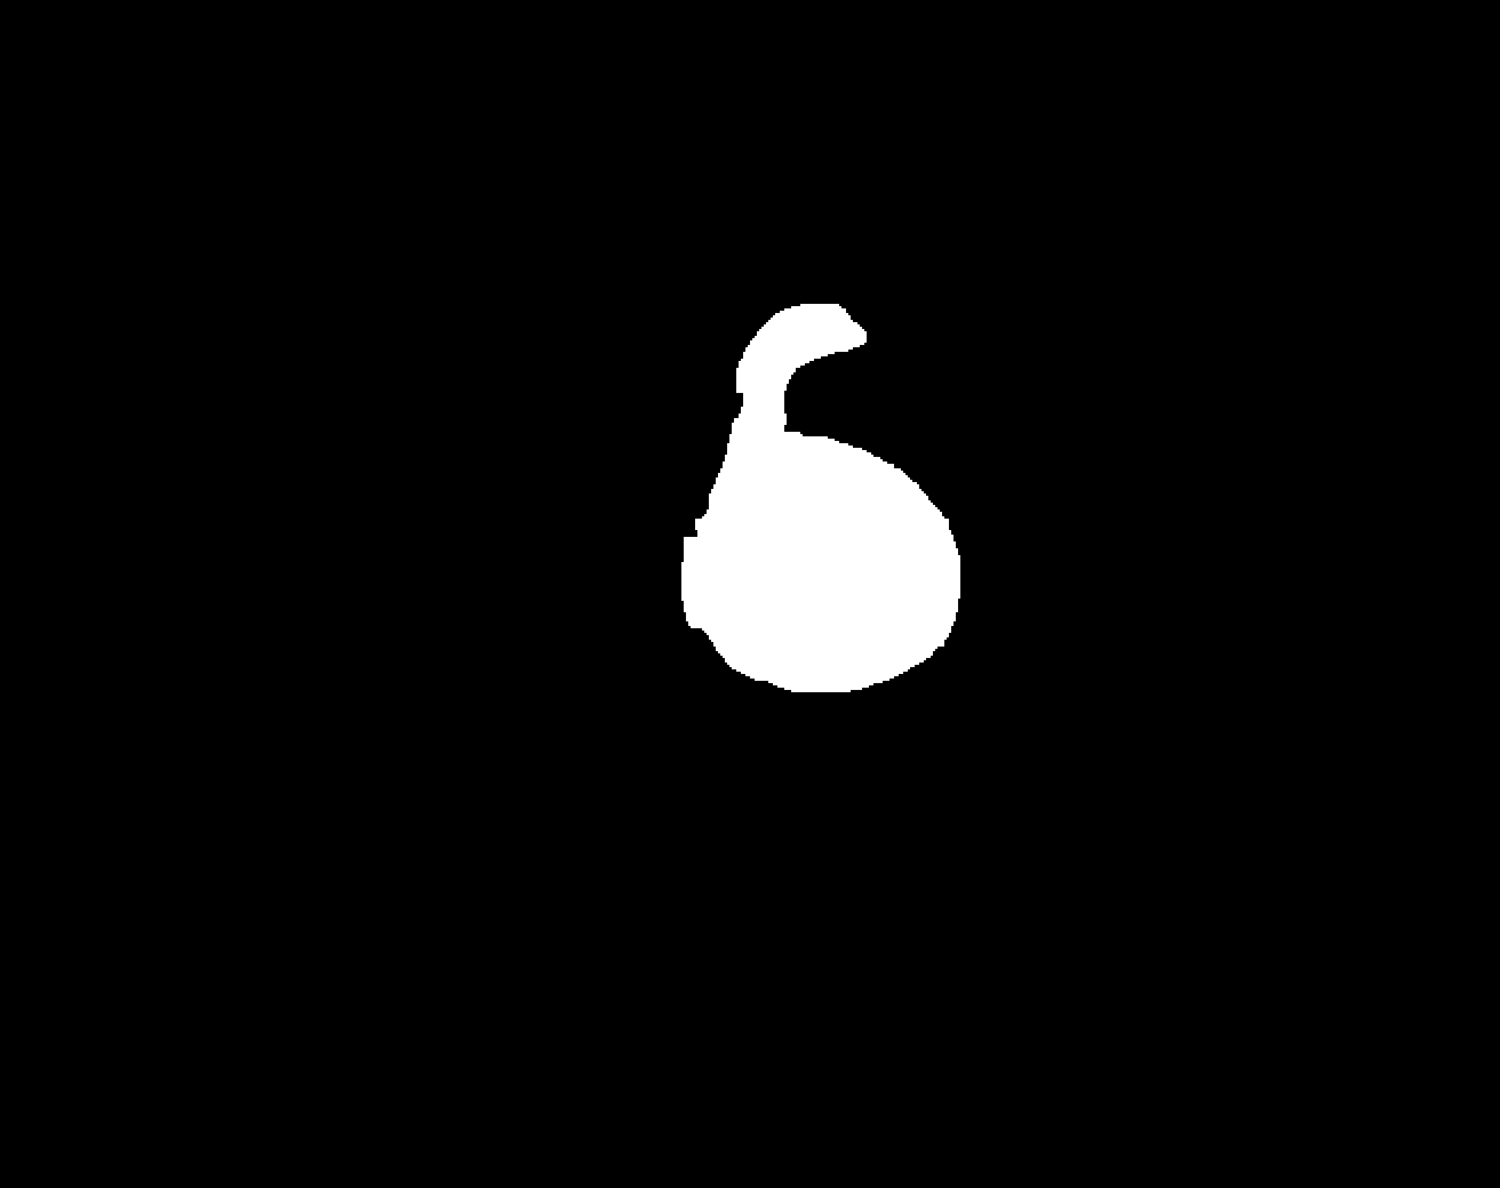
Why deep segmentation?
Classical segmentation can be affected by:
Blooming and saturated regions
Weak or ambiguous meltpool boundaries
Background noise and thermal drift
Strong dependence on threshold selection
IR frame
Classical mask
Notes:
Classical segmentation methods are attractive because they are simple, fast, and easy to implement.
For example, fixed thresholding, adaptive thresholding, morphological filtering, and contour extraction can be implemented with low computational cost.
However, they are highly dependent on parameter selection and image normalization.
In this example, the thermal image contains a bright core, but also blooming, thermal halos, and an ambiguous boundary.
Depending on the selected threshold, the resulting mask may include regions that are not necessarily part of the meltpool, or may miss relevant parts of the active region.
So, the motivation for deep segmentation is not that classical methods are useless.
The motivation is that learned models may provide more robust masks under changing thermal conditions.

Slide 6
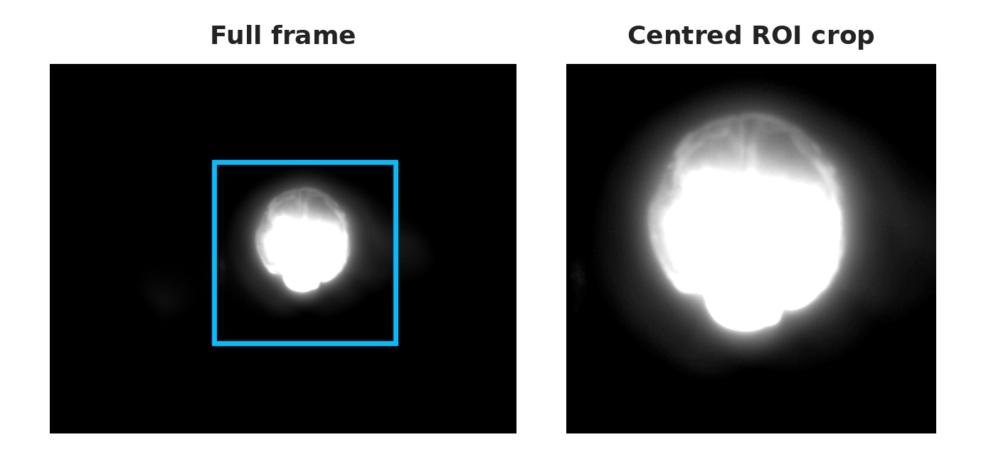
Dataset and task formulation
Infrared thermographic images
Manual pixel-level annotations
Binary meltpool segmentation
1125 manually annotated images with a fixed 80/20 training/validation split
Deployment benchmark: separate set of 1025 thermographic images
Input resolution size variations (128,224,512 px)
Input | IoU
Full-128 | 0.902
Full-224 | 0.906
ROI-128 | 0.918
ROI-224 | 0.925
Notes:
The dataset used for training and validation contains 1125 manually annotated thermographic images.
Each image was annotated at pixel level to generate a binary mask of the meltpool region.
We used a fixed 80/20 training and validation split for all model configurations.
This is important because it ensures that the comparison between architectures and optimization strategies is fair.
In addition, a separate set of 1025 thermographic images was used for the deployment-oriented inference benchmark.
We also evaluated different input configurations, including full-frame inputs and region-of-interest inputs.
The reason is that the meltpool occupies only a small part of the original thermographic frame.

Slide 7
Model selection
Hardware platforms used for inference
Platform | GPU | CPU | GPU Memory
Machine 1 | NVIDIA Quadro RTX 6000 | Intel Xeon E5-1650 | 24 GB
Machine 2 | NVIDIA RTX A500 Laptop GPU | Intel Core i7-13800H | 6 GB
Architecture screening (Input ROI-224)
Decoder | Encoder | IoU | Dice | GPU ms | Params
U-Net | Resnet18 | 0.925 | 0.961 | 3.227 | 14.32M
U-Net | MobileNetV2 | 0.924 | 0.961 | 5.048 | 3.97M
U-Net | EfficientNet-b0 | 0.922 | 0.959 | 11.740 | 6.25M
DeeplabV3+ | ResNet18 | 0.910 | 0.953 | 3.117 | 16.41M
DeeplabV3+ | MobileNetV2 | 0.916 | 0.956 | 5.091 | 3.97M
Notes:
For the initial model selection, we focused on U-Net and DeepLabV3+-type architectures.
Both are configurable encoder-decoder segmentation models, which allowed us to compare different encoders under a common framework.
As encoders, we evaluated ResNet, MobileNetV2, and EfficientNet.
The experiments were carried out on two machines. Machine 1 was used as the main benchmark platform, while Machine 2 was included to evaluate portability to a secondary inference platform.
All benchmarks at this stage were performed in PyTorch.
The architecture screening showed that U-Net with a ResNet encoder provided the best compromise between segmentation quality and inference latency.
An important observation is that lower parameter count did not automatically mean lower latency.
Latency also depends on operator implementation, memory access patterns, hardware utilization, and the runtime environment.
For this reason, U-Net with a ResNet encoder was selected for the detailed optimization study.

Slide 8
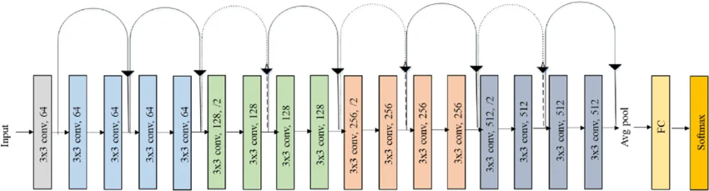
Encoder simplification
Resnet18 encoder simplification
64 ch
128 ch
256 ch
512 ch
Reduced Filters
Reduce feature channels
eg. 32/64/128/224
Reduced blocks
Use fewer residual units inside each stage
Reduced stages
Remove the deepest stage to reduce encoder depth
Notes:
After selecting the U-Net ResNet model family, we analysed whether the encoder could be simplified.
The idea was to test if the baseline model contained more capacity than required for this specific thermographic segmentation task.
In this scheme, filters refer to the number of feature channels in the convolutional layers.
Blocks refer to the number of residual units inside each encoder stage.
Stages refer to the depth of the encoder, especially the deepest stage.
We evaluated these reductions individually and in combination.
The objective was to reduce model size and inference latency while preserving useful segmentation quality for reliable meltpool descriptor extraction.

Slide 9
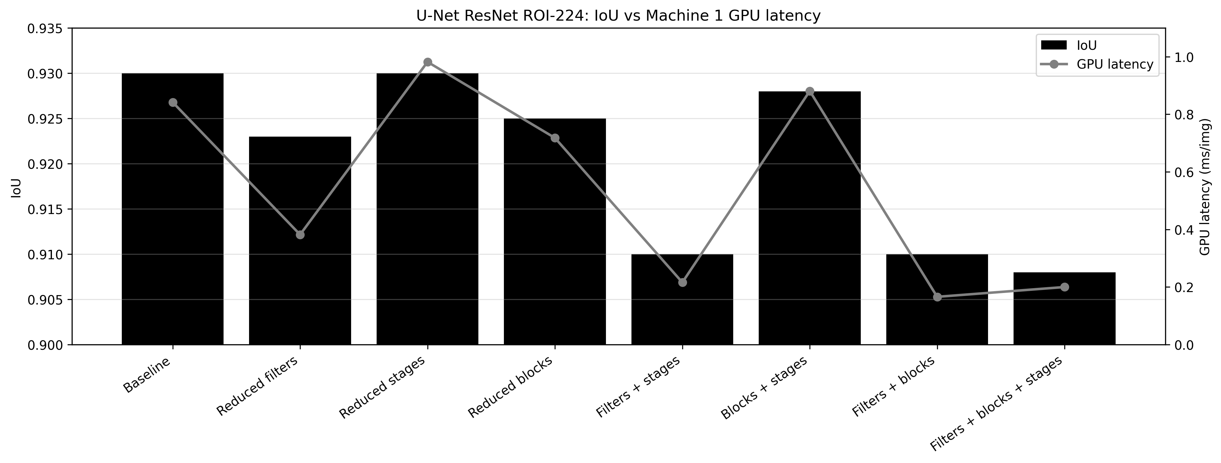
Simplification results
Notes:
This slide shows the trade-off between segmentation quality and GPU latency for the simplified U-Net ResNet configurations.
The baseline model achieved the highest segmentation quality, but it was also larger and more computationally expensive.
Several compact configurations achieved slightly lower IoU, but with a significant reduction in latency.
This is important because the model can be fast and compact enough for the deployment scenario.
The main message is that encoder simplification provides different operating points depending on the constraint.
For example, maximum accuracy, lower latency, smaller size, or better portability.

Slide 10
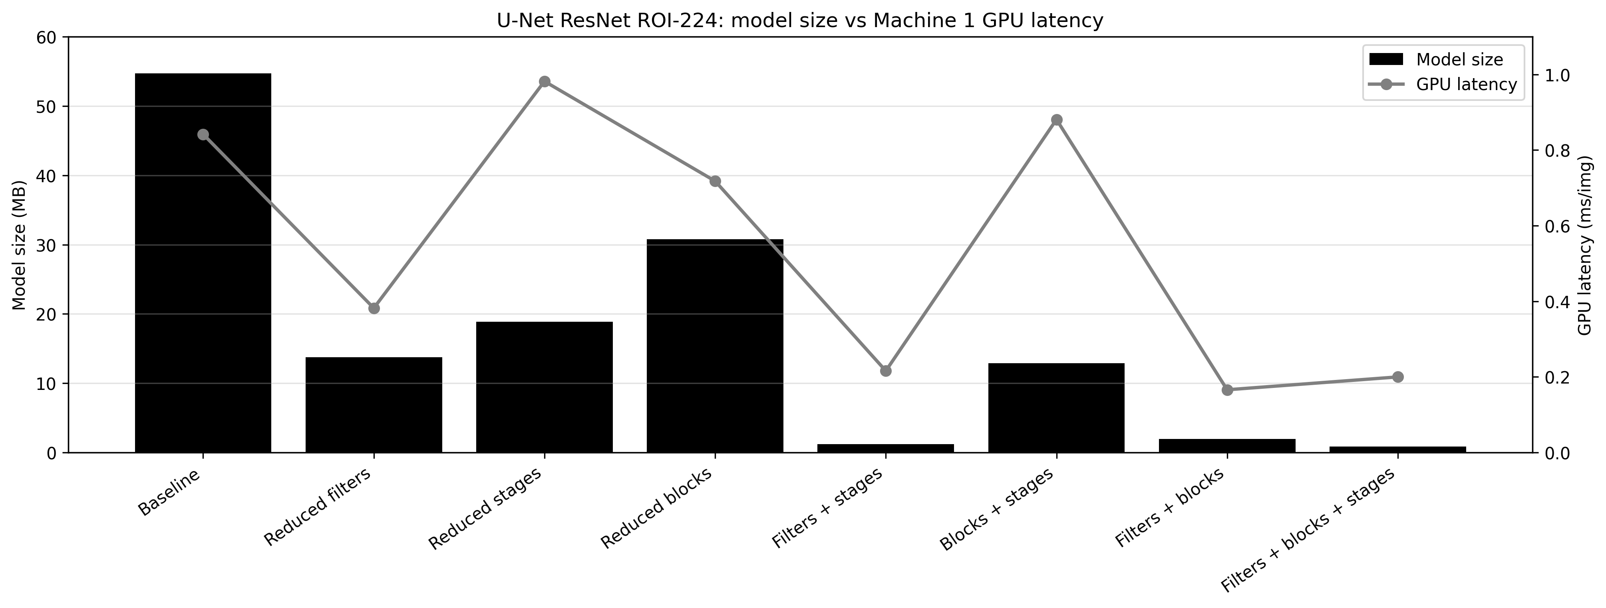
Simplification results
Notes:
This second result focuses on the relation between model size and latency.
The compact configurations strongly reduce the model size compared with the baseline.
Some reduced variants decrease the model size from tens of megabytes to only a few megabytes or less.
This reduction is useful not only for faster inference, but also for deployment on systems where memory and computational resources are limited.
Again, the selected model should depend on the deployment requirement, not only on the highest IoU value.

Slide 11
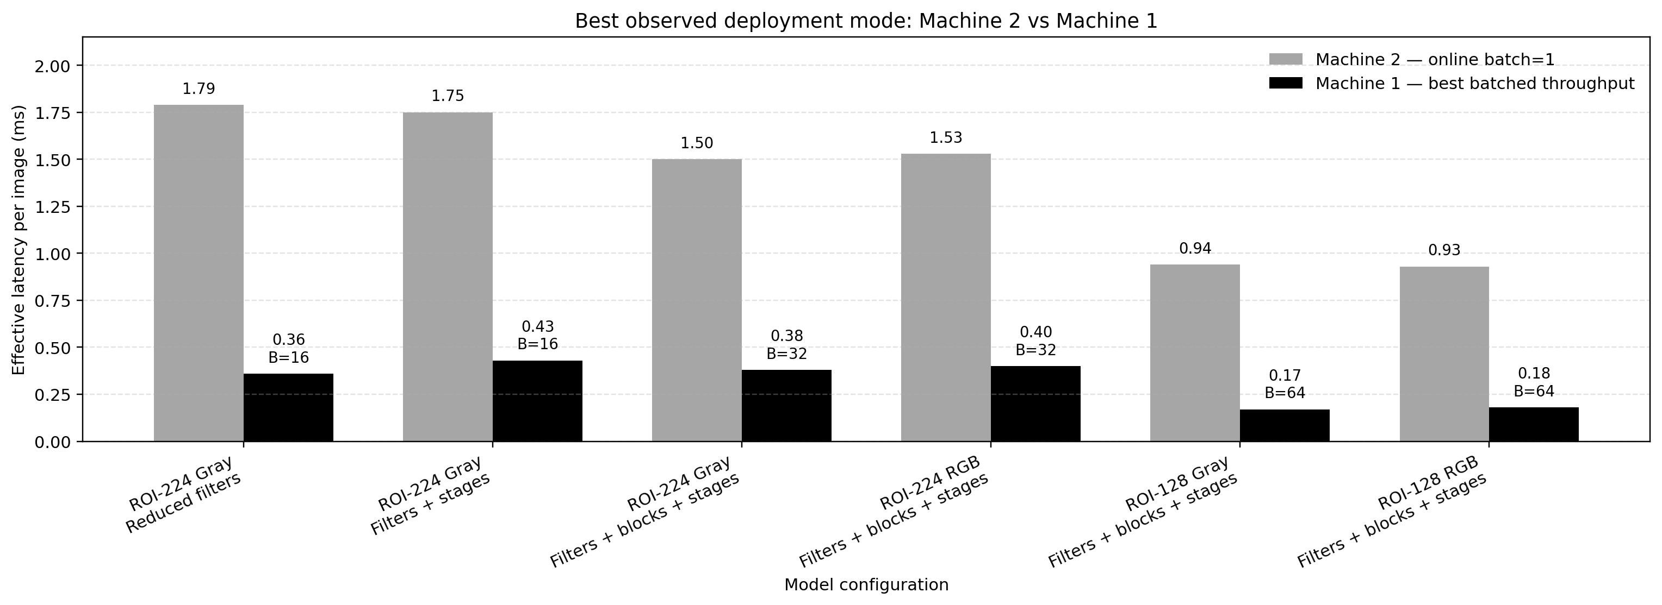
Deployment benchmark
Notes:
For the final deployment benchmark, inference was evaluated over a separate set of 1025 thermographic images.
It is important to clarify the latency interpretation.
The preliminary architecture and input comparisons used batch size 1.
In contrast, the final deployment benchmark used batched inference.
Therefore, the reported values are effective latency per image under buffered or micro-batched inference.
They should not be interpreted as strict single-frame closed-loop latency.
This slide compares the selected compact models on Machine 1 and Machine 2.
The purpose is not to rank the GPUs theoretically, but to assess whether the reduced models remain practical on different inference platforms.
At this stage, all benchmarks were performed in PyTorch.
ONNX and TensorRT deployment are considered as the next step after selecting the most suitable compact models.

Slide 12
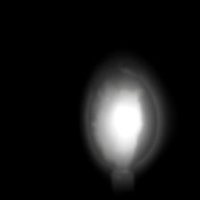
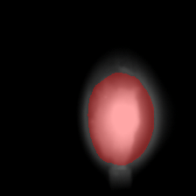
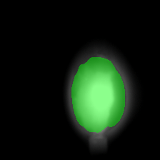
Conclusions and Outlook
Raw image
ROI-based U-Net ResNet models provide a good accuracy–latency trade-off
Encoder simplification enables compact deployment candidates
Design a lighter CNN architecture based on the evaluated encoders
ONNX / TensorRT deployment and runtime-specific optimization
Evaluation on edge devices, including NVIDIA Jetson platforms
Key takeaways
Outlook
Ground truth
Prediction
Notes:
To conclude, this work evaluated deep segmentation models for infrared thermographic meltpool monitoring, considering both segmentation quality and deployment cost.
The results show that ROI-based U-Net ResNet models provide a good accuracy-latency trade-off.
Encoder simplification can significantly reduce model size and inference latency while preserving useful segmentation quality.
As an outlook, this benchmark will be used as a design guide for lighter edge-oriented CNN architectures.
The next step is to optimize selected models using ONNX and TensorRT, and to evaluate them on additional edge devices, including NVIDIA Jetson platforms.

Slide 13
Iago Gil Cortés – S³M Engineer
Phone: +34 986 344 000 – iago.gil@aimen.es
This research has been supported by the Horizon Europe research and innovation programme under grant agree-
ment No. 101091780, the DaCapo project ,
and grant agreement No. 101138506, the M4estro project .

